Slide 1
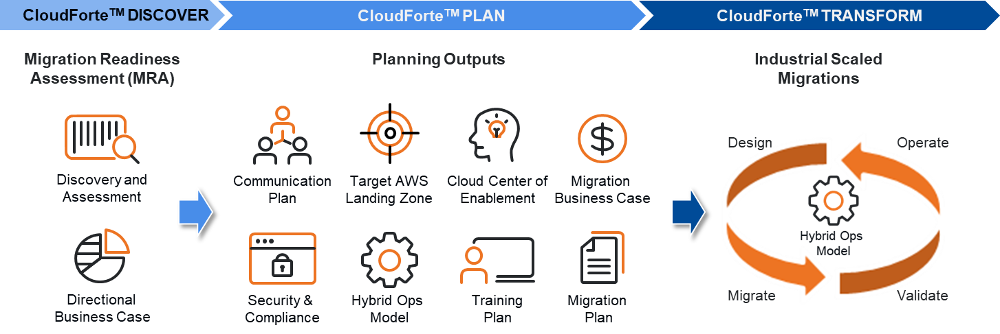
The CloudForteTM Migration Accelerator
Frameworks and Enablers:
The Migration Readiness Assessment (MRA) helps assess organizational cloud migration capabilities, readiness, and commitment.
The CloudForteTM Migration Accelerator provides a proven comprehensive business-driven methodology and associated toolkit to accelerate the cloud migration journey.
Our Migration Accelerator approach provides structure to identify and address gaps in skills and processes, and produces an actionable plan to guide the cloud adoption journey.
The AWS Well Architected Framework (WAF) is used to assess and optimize applications and workloads to take advantage of AWS native features of resilience, scalability and cost efficiency while also assuring a continuous cyber security posture.
Best Practices:
Prioritize legacy IT assets to migrate to enable Federal customers to measurably decrease time-to-market and increase return-on-investment as quickly as possible.
Leverage the Unisys dedicated Cloud Center of Enablement (CCoE), community of 300+ certified cloud Subject Matter Experts and established partnership with AWS to enable the continuous improvement of cloud foundations, applications and operations.
Develop migration approach and plan that addresses not only the applications to be migrated, but also the impact to the business (people, process, policies & procedures).
Define Landing Zones to provide foundation for accelerated application migrations.
Notes:
[EXECUTING MIGRATION JOURNEY]: So how is the migration journey executed and accelerated?
Following the MRA, the initial planning focus is on Portfolio Discovery and Planning, Business Case development and Workload Evaluation and Selection
This planning forms the basis for the initial or first wave of execution during the MRA – which includes creating a Migration Plan, Landing Zone, App Design/Migration/Validation, and operation of the migrated applications
Continual migrations wave follow, each building upon the experience of the previous wave.
Throughout this process cloud expertise is built as an Operation Model, Security & Compliance and Center of Excellence are developed over time. An agile process is used with sprints focused on developing the cloud expertise and operation polices & procedures to successfully migrate and operate each wave of targeted workloads.
Throughout all this, the Migration Resource Toolkit provides best practices, experiences, artifacts, migration patterns all developed through the experience of migrating over 100 enterprise customers.
After many waves of migration and sprints to build cloud expertise, your cloud operating model evolves and matures to successfully manage and operate your migrated applications

Slide 2

The Migration Readiness Assessment (MRA): Business Case
Business Capability Focused | Business Value Realization
 | People Roles and Readiness
 | Governance Prioritization and Control
Technical Capability Focused | Platform Applications and Infrastructure
 | Security Risk and Compliance
 | Operations Hybrid and Dynamic
The Business Perspective
Covers the following perspectives
IT Finance
IT Strategy
Benefits Realization
Business Risk Management
Focused on ensuring that IT is aligned with business needs and that IT investments can be traced to demonstrable business results
Engages stakeholders to create a strong business case for cloud adoption, to prioritize cloud adoption initiatives, and to ensure that there is a strong alignment between your organization’s business strategies and goals and IT strategies and goals
Notes:
[EXECUTING MIGRATION JOURNEY]: So how is the migration journey executed and accelerated?
Following the MRA, the initial planning focus is on Portfolio Discovery and Planning, Business Case development and Workload Evaluation and Selection
This planning forms the basis for the initial or first wave of execution during the MRA – which includes creating a Migration Plan, Landing Zone, App Design/Migration/Validation, and operation of the migrated applications
Continual migrations wave follow, each building upon the experience of the previous wave.
Throughout this process cloud expertise is built as an Operation Model, Security & Compliance and Center of Excellence are developed over time. An agile process is used with sprints focused on developing the cloud expertise and operation polices & procedures to successfully migrate and operate each wave of targeted workloads.
Throughout all this, the Migration Resource Toolkit provides best practices, experiences, artifacts, migration patterns all developed through the experience of migrating over 100 enterprise customers.
After many waves of migration and sprints to build cloud expertise, your cloud operating model evolves and matures to successfully manage and operate your migrated applications

Slide 3
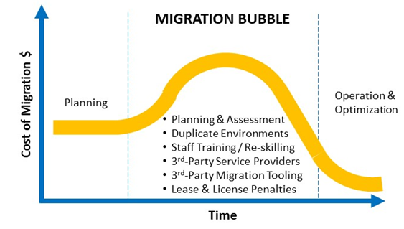
MRA Findings Inform Business Case Work Stream
Business Capability Focused | Business Value Realization
 | People Roles and Readiness
 | Governance Prioritization and Control
Technical Capability Focused | Platform Applications and Infrastructure
 | Security Risk and Compliance
 | Operations Hybrid and Dynamic
Define Anticipated Benefits
Define Current Costs¹
Define Migration Costs²
Define Anticipated Cloud Costs
Develop/Refine Business Case
Measure Actual Costs and Benefits
Begin Migration
Develop Directional Business Case
¹ - Current Costs Include
² - Migration Costs Include
Servers
Storage
Networking
Power
Cooling
Physical Space
IT Labor
Software Licenses
Planning & Assessment
Duplicate Environments
Staff Training / Re-skilling
3rd-Party Service Providers
3rd-Party Migration Tooling
Lease & License Penalties
Notes:
[EXECUTING MIGRATION JOURNEY]: So how is the migration journey executed and accelerated?
Following the MRA, the initial planning focus is on Portfolio Discovery and Planning, Business Case development and Workload Evaluation and Selection
This planning forms the basis for the initial or first wave of execution during the MRA – which includes creating a Migration Plan, Landing Zone, App Design/Migration/Validation, and operation of the migrated applications
Continual migrations wave follow, each building upon the experience of the previous wave.
Throughout this process cloud expertise is built as an Operation Model, Security & Compliance and Center of Excellence are developed over time. An agile process is used with sprints focused on developing the cloud expertise and operation polices & procedures to successfully migrate and operate each wave of targeted workloads.
Throughout all this, the Migration Resource Toolkit provides best practices, experiences, artifacts, migration patterns all developed through the experience of migrating over 100 enterprise customers.
After many waves of migration and sprints to build cloud expertise, your cloud operating model evolves and matures to successfully manage and operate your migrated applications

Slide 4
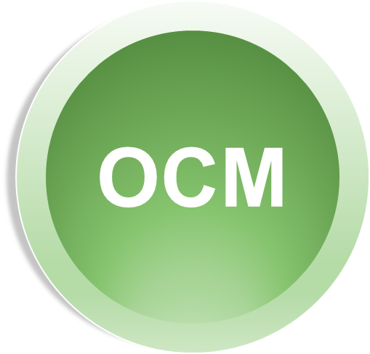
The Migration Readiness Assessment (MRA): Organizational Change Management (OCM)
Business Capability Focused | Business Value Realization
 | People Roles and Readiness
 | Governance Prioritization and Control
Technical Capability Focused | Platform Applications and Infrastructure
 | Security Risk and Compliance
 | Operations Hybrid and Dynamic
Covers the following organizational staff capabilities and change management functions required for efficient cloud adoption
Resource Management
Incentive Management
Career Management
Training Management
Organizational Change Management
Engages stakeholders to evaluate organizational structures and roles, define new skill and process requirements, and identify gaps
Enables leadership to communicate changes to the organization
Supports development of an organization-wide change management strategy for successful cloud adoption
The People Perspective
Notes:
[EXECUTING MIGRATION JOURNEY]: So how is the migration journey executed and accelerated?
Following the MRA, the initial planning focus is on Portfolio Discovery and Planning, Business Case development and Workload Evaluation and Selection
This planning forms the basis for the initial or first wave of execution during the MRA – which includes creating a Migration Plan, Landing Zone, App Design/Migration/Validation, and operation of the migrated applications
Continual migrations wave follow, each building upon the experience of the previous wave.
Throughout this process cloud expertise is built as an Operation Model, Security & Compliance and Center of Excellence are developed over time. An agile process is used with sprints focused on developing the cloud expertise and operation polices & procedures to successfully migrate and operate each wave of targeted workloads.
Throughout all this, the Migration Resource Toolkit provides best practices, experiences, artifacts, migration patterns all developed through the experience of migrating over 100 enterprise customers.
After many waves of migration and sprints to build cloud expertise, your cloud operating model evolves and matures to successfully manage and operate your migrated applications

Slide 5
The Migration Readiness Assessment (MRA): OCM
Business Capability Focused | Business Value Realization
 | People Roles and Readiness
 | Governance Prioritization and Control
Technical Capability Focused | Platform Applications and Infrastructure
 | Security Risk and Compliance
 | Operations Hybrid and Dynamic
Covers the following organizational staff capabilities required for efficient cloud adoption
Portfolio Management
Program and Project Management
Business Performance Measurement
License Management
Focuses on the staff skills and organizational processes that are necessary to ensure business governance in the cloud, to align IT strategy and goals with mission strategy and goals, and to manage and measure cloud investments to evaluate their mission outcomes
Provides key inputs to the organization-wide change management strategy for successful cloud adoption
The Governance Perspective
Notes:
[EXECUTING MIGRATION JOURNEY]: So how is the migration journey executed and accelerated?
Following the MRA, the initial planning focus is on Portfolio Discovery and Planning, Business Case development and Workload Evaluation and Selection
This planning forms the basis for the initial or first wave of execution during the MRA – which includes creating a Migration Plan, Landing Zone, App Design/Migration/Validation, and operation of the migrated applications
Continual migrations wave follow, each building upon the experience of the previous wave.
Throughout this process cloud expertise is built as an Operation Model, Security & Compliance and Center of Excellence are developed over time. An agile process is used with sprints focused on developing the cloud expertise and operation polices & procedures to successfully migrate and operate each wave of targeted workloads.
Throughout all this, the Migration Resource Toolkit provides best practices, experiences, artifacts, migration patterns all developed through the experience of migrating over 100 enterprise customers.
After many waves of migration and sprints to build cloud expertise, your cloud operating model evolves and matures to successfully manage and operate your migrated applications

Slide 6
MRA Findings Inform OCM Roadmap Work Stream
OCM Outputs
Business Capability Focused | Business Value Realization
 | People Roles and Readiness
 | Governance Prioritization and Control
Technical Capability Focused | Platform Applications and Infrastructure
 | Security Risk and Compliance
 | Operations Hybrid and Dynamic
Cloud Center of Excellence (CCoE)
Communication Plan
Training Plan
Hybrid Ops Role Mapping
RACI Matrix
Overall OCM Plan
Change Impact Analysis
Evaluator Tool and Assessment Checklist
Adoption Metrics and Measurement Strategy & Tools
Sustainment
Strategy
OCM ROI
High % user adoption and usage
Benefit realization
Value creation
Project delivery promise met
Measurement
Analysis
Support
Engagement
Notes:
[EXECUTING MIGRATION JOURNEY]: So how is the migration journey executed and accelerated?
Following the MRA, the initial planning focus is on Portfolio Discovery and Planning, Business Case development and Workload Evaluation and Selection
This planning forms the basis for the initial or first wave of execution during the MRA – which includes creating a Migration Plan, Landing Zone, App Design/Migration/Validation, and operation of the migrated applications
Continual migrations wave follow, each building upon the experience of the previous wave.
Throughout this process cloud expertise is built as an Operation Model, Security & Compliance and Center of Excellence are developed over time. An agile process is used with sprints focused on developing the cloud expertise and operation polices & procedures to successfully migrate and operate each wave of targeted workloads.
Throughout all this, the Migration Resource Toolkit provides best practices, experiences, artifacts, migration patterns all developed through the experience of migrating over 100 enterprise customers.
After many waves of migration and sprints to build cloud expertise, your cloud operating model evolves and matures to successfully manage and operate your migrated applications

Slide 7

The Migration Readiness Assessment (MRA): Operations Integration (OI)
Business Capability Focused | Business Value Realization
 | People Roles and Readiness
 | Governance Prioritization and Control
Technical Capability Focused | Platform Applications and Infrastructure
 | Security Risk and Compliance
 | Operations Hybrid and Dynamic
Covers the following processes and tooling
Compute Provisioning
Network Provisioning
Storage Provisioning
Database Provisioning
Systems and Solution Architecture
Application Development
Focuses on the processes that are necessary to deliver and optimize cloud solutions and services
Describes the architecture of the target state environment in detail, and includes principles and patterns for implementing new solutions on the cloud, and for migrating on-premises workloads to the cloud
Identifies which platform services can be adopted to generate cost benefit of improved agility
The Platform Perspective

Slide 8
The Migration Readiness Assessment (MRA): OI
OI
Business Capability Focused | Business Value Realization
 | People Roles and Readiness
 | Governance Prioritization and Control
Technical Capability Focused | Platform Applications and Infrastructure
 | Security Risk and Compliance
 | Operations Hybrid and Dynamic
Covers the following process, policies and tooling for efficient cloud adoption
Identity and Access Management
Infrastructure Security
Data Protection
Incident Response
Focuses on the processes that are necessary to ensure that the architecture deployed in the cloud aligns to the organization’s security control requirements, resiliency, and compliance requirements
Enables the selection and implementation of security controls, services and features that meet your organization’s security objectives for visibility, auditability, control, and agility
Helps drive the transformation of your organization’s security culture
Expedites attainment of GSS and Application level ATO
The Security Perspective

Slide 9
The Migration Readiness Assessment (MRA): OI
OI
Business Capability Focused | Business Value Realization
 | People Roles and Readiness
 | Governance Prioritization and Control
Technical Capability Focused | Platform Applications and Infrastructure
 | Security Risk and Compliance
 | Operations Hybrid and Dynamic
Covers the following processes for efficient cloud adoption
Service Monitoring
Application Performance Monitoring
Resource Inventory Management
Release / Change Management
Reporting and Analytics
Business Continuity / Disaster Recovery
IT Service Catalog
Focuses on the staff skills and organizational processes that are necessary to enable, run, use, operate, and recover IT workloads to the level that is agreed upon with your business stakeholders
Defines current operating procedures, and identifies process changes and training needed to ensure system health and reliability during the move of operations to the cloud and then to operate using agile, ongoing, cloud computing best practices
Addresses Service Level Management
The Operations Perspective

Slide 10
MRA Findings Inform OI Work Stream
Business Capability Focused | Business Value Realization
 | People Roles and Readiness
 | Governance Prioritization and Control
Technical Capability Focused | Platform Applications and Infrastructure
 | Security Risk and Compliance
 | Operations Hybrid and Dynamic
Assess Operational Starting Point
Define Objectives
Define Gaps
Develop Operational Integration Plan
Validate Recommendations
Develop Recommendations
OI Outputs
Cloud / Hybrid Operating Model
Hybrid Ops Shared Responsibility Matrix
Operational Integration Plan
Notes:
[EXECUTING MIGRATION JOURNEY]: So how is the migration journey executed and accelerated?
Following the MRA, the initial planning focus is on Portfolio Discovery and Planning, Business Case development and Workload Evaluation and Selection
This planning forms the basis for the initial or first wave of execution during the MRA – which includes creating a Migration Plan, Landing Zone, App Design/Migration/Validation, and operation of the migrated applications
Continual migrations wave follow, each building upon the experience of the previous wave.
Throughout this process cloud expertise is built as an Operation Model, Security & Compliance and Center of Excellence are developed over time. An agile process is used with sprints focused on developing the cloud expertise and operation polices & procedures to successfully migrate and operate each wave of targeted workloads.
Throughout all this, the Migration Resource Toolkit provides best practices, experiences, artifacts, migration patterns all developed through the experience of migrating over 100 enterprise customers.
After many waves of migration and sprints to build cloud expertise, your cloud operating model evolves and matures to successfully manage and operate your migrated applications

Slide 11
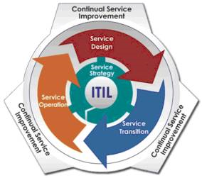
From ITIL to a Cloud Operations Model
Core Operations Functions
Security & Control Functions
Business Mgmt Functions
Supporting Functions
Platform Architecture & Governance
IT Change & Release Management
Financial Management
Reporting & Analytics
Event & Incident Management
Resource Inventory Management
Capacity Management
Continuous Improvement
Provisioning & Configuration Management
Identity & Access Management
Organizational Change Management
Application Lifecycle Management
Key to Colors
Service Strategy
Service Design
Availability & Continuity Management
Security Management
Vendor Management
Service Transition
Service Operation
Continual Service Improvement
Notes:
[EXECUTING MIGRATION JOURNEY]: So how is the migration journey executed and accelerated?
Following the MRA, the initial planning focus is on Portfolio Discovery and Planning, Business Case development and Workload Evaluation and Selection
This planning forms the basis for the initial or first wave of execution during the MRA – which includes creating a Migration Plan, Landing Zone, App Design/Migration/Validation, and operation of the migrated applications
Continual migrations wave follow, each building upon the experience of the previous wave.
Throughout this process cloud expertise is built as an Operation Model, Security & Compliance and Center of Excellence are developed over time. An agile process is used with sprints focused on developing the cloud expertise and operation polices & procedures to successfully migrate and operate each wave of targeted workloads.
Throughout all this, the Migration Resource Toolkit provides best practices, experiences, artifacts, migration patterns all developed through the experience of migrating over 100 enterprise customers.
After many waves of migration and sprints to build cloud expertise, your cloud operating model evolves and matures to successfully manage and operate your migrated applications

